Slide 1

Academic Session 2026-27
ODD Semester July-Dec 2026
UNIVERSITY INSTITUTE OF ENGINEERING AND TECHNOLOGY
Department of TT
Bachelor of Engineering (B.E.) – CSE
Advanced Data Structures / Semester 3
(CS221)
Unit No. 1 Chapter No. 1.1 Lecture No. 2
Topic : Introduction to Data Structures
Abhishek Thakur (E19789) Technical Trainer
Sourav Jaiswal (E19756)-MSC Technical Trainer

Slide 2
Learning Objectives
Define data structures and understand their role in programming.
Classify data structures into primitive and non-primitive types.
Identify linear vs. non-linear data structures with real-world examples.
Understand common operations performed on data structures.

Slide 3
What is a Data Structure?
Data Structure: A named collection of data items organised so they can be stored, accessed, and manipulated efficiently.
Why needed: To store and manage large amounts of data and enable fast operations — search, insert, delete, sort.
Key properties: Defines the relationship between data elements and the operations that can be applied to them.
Examples: Array, Linked List, Stack, Queue, Tree, Graph, Hash Table.
Choosing wisely: The right data structure is critical for writing efficient algorithms and software.

Slide 4
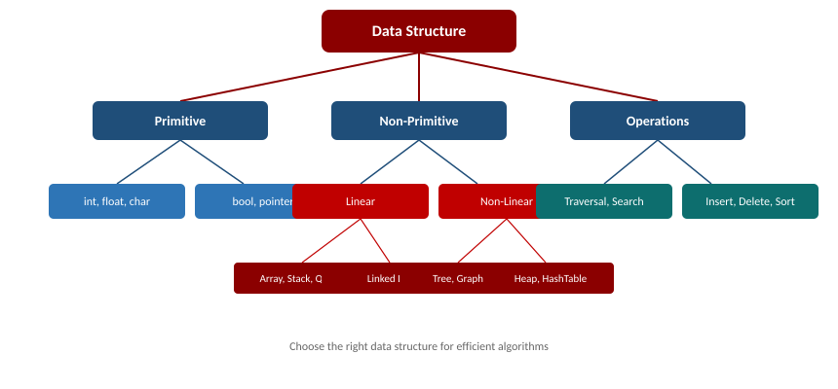
Classification of Data Structures

Slide 5
Applications of Data Structures
Databases: B-Trees and Hash Tables enable fast record lookup and indexing.
Operating Systems: Queues manage CPU process scheduling; Stacks handle function calls.
GPS / Navigation: Graphs model road networks; Dijkstra finds shortest paths.
Compilers: Stacks evaluate arithmetic expressions and manage syntax trees.
Social Networks: Graphs model user connections and drive friend recommendations.

Slide 6
Summary of the Lecture
A data structure organises data for efficient storage, access, and modification.
Primitive types: int, float, char, bool. Non-primitive: Array, List, Tree, Graph.
Linear structures (Array, Stack, Queue) store elements sequentially.
Non-linear structures (Tree, Graph) represent hierarchical or networked data.
Choosing the right data structure is fundamental to efficient algorithm design.

Slide 7

Next Lecture
Introduction to Sorting; Algorithm Complexity, Time-Space Tradeoff & Asymptotic Notations.

Slide 8
Quiz/ FAQ's
Q1. What is a data structure? How does it differ from a data type?
Q2. Differentiate between linear and non-linear data structures with two examples each.
Q3. List four operations commonly performed on data structures.

Slide 9
References/ Articles
Seymour Lipschutz, Data Structures, Schaum's Outlines, McGraw-Hill.
Reema Thareja, Data Structures Using C, Oxford University Press, 2nd Ed.
GeeksforGeeks: https://www.geeksforgeeks.org/data-structures/

Slide 10
Thank You
For queries
Email: abhishek.e19789@cumail.in

